Slide 1




Encouraging Open Science
Jack Prominski & Pragati Shah
Public Library of Science, Sponsor
The Bourne Laboratory, Sponsor
Dr. Phil Bourne, Advisor
Dr. Peter Alonzi, Technical Advisor
Dr. Daniel Mietchen, Technical Advisor

Slide 2
Why Open Science is Important
•Improved Reproducibility of Research
•Accelerated Scientific Discovery
•Public Enrichment
•Improved Education

Slide 3
Problem Statement
PLOS receives 25,000 article submissions per year and publishes 50% of them. Readers struggle sifting through the overwhelming amount of scholarly work, and PLOS’ manuscript review process is slowed by the tedious manual checks they must perform on each submission.

Slide 4
Goals
Deliver an analysis of the corpus to PLOS leadership
Recommend more relevant content to PLOS readers
Improve the efficiency of PLOS manuscript review process
Notes:
First goal is to gain an understanding of the data set. PLOS has never done any analysis on their corpus

Slide 5




Our Data
300,000+ JATS XML files
Notes:
The Journal Article Tag Suite (JATS) is a standard that defines a set of XML elements and attributes for tagging journal articles and describes three article models. The JATS standard has evolved over time, and hence there exist some consistency issues, which we encountered in parsing. Our data is sourced from PLOS and PubMed via FTP. Why both, you may ask?
Good question! Both sites maintain different formats of the same academic paper. PubMed has richer references, with a Pub-Med ID as an identifier for the reference. PLOS on the other hand, does not have any identifiers in the references apart from paper name which is quite frustrating. Also, all of the references of a PLOS paper may not be published in PLOS and are not part of the PLOS corpora but are present in PubMed.
Papers downloaded via FTP. Python for parsing. Not relational data, and not standard. Hence use of a non-relational document database like mongoDB to store the preprocessed documents.

Slide 6

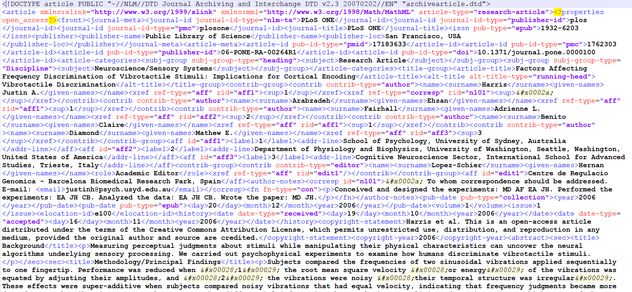
Pre-processing
Dictionary
PMID:
Authors:
Subject:
Title:
17183633
Justin Harris
Ehsan Arabzadeh
Adrienne Fairhall
Claire Benito
Neuroscience/Sensory Systems
Factors Affecting Frequency Discrimination of Vibrotactile Stimuli: Implications for Cortical Encoding
….
Notes:
XML parsing using the ElementTree XML API in Python, which has elements useful in iterating recursively over sub-trees. Messy XML, cluttered, to a straightforward dictionary. Challenges: Highly nested xml with a non standard structure. For instance one paper may have a different number of references than another, and the references have varying number of authors. Another challenge is extracting an expanse of text via a tag, where other tags may open before the text tag closes (eg. italics, paranthesis, citations etc).

Slide 7
Feature Engineering
Topic Modeling
Topic
“protein”
“activ”
“bind”
“structur”
“function"
Topic
“cancer”
“tumor”
“cell”
“patient”
“studi"
Topic
“gene”
“sequenc”
“genom”
“genet”
“express"
Topic
“infec”
“virus”
“hiv”
“diseas”
“vaccin"
Topic
“drug”
“effect”
“use”
“activ”
“treatment"
Notes:
LDA Topic modeling on a subset of 10,000 articles from the journal PLOS One
Here is a sample of thematically relevant topics
This can be used to drive measures of article similarity -- which could be a component of our recommendation system
Thus far, we’ve only been working on a subset of data -- will need to scale things up

Slide 8
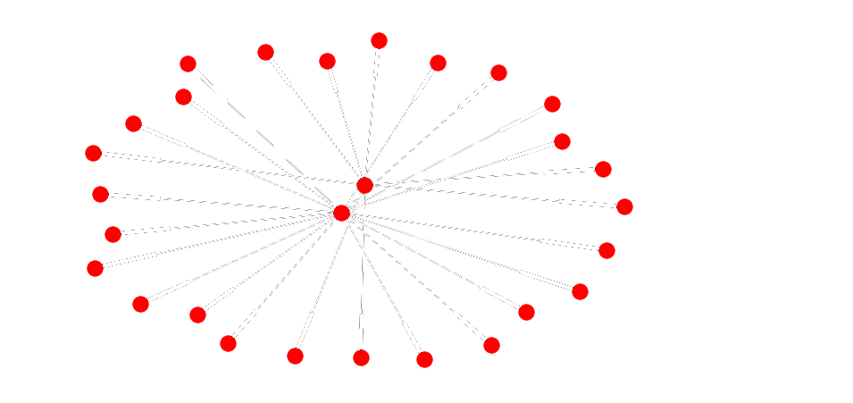
References Network Graph
Notes:
Use of Python library NetworkX to build network graph of citations. For a clean visualization we are visualizing two papers and their references. One paper is a reference of the other paper. Nodes: Pubmed ids of papers. Edges: Paper, Reference. Challenge: All citations may not be part of the PLOS corpus. Also, there is no standard ID which is used (EG: the DOI, PMC, PMID are all used. Hence we may need to create a lookup of these)

Slide 9
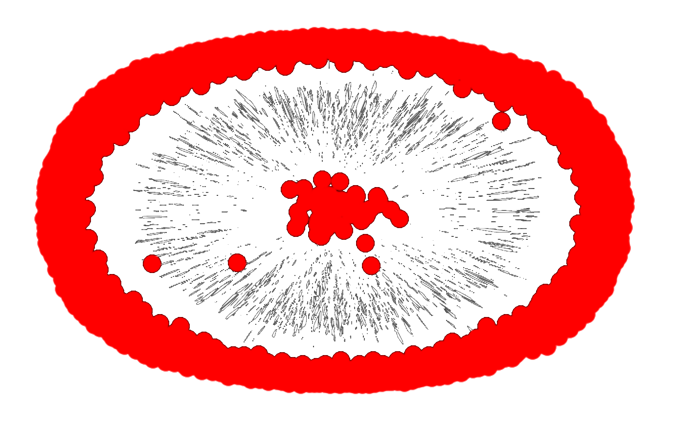
References Network Graph
Notes:
Why only two papers. Well, this is what happens when you select a subset of 50 papers. Close to 1300 edges and over 1200 nodes. Clearly, large and dense network graphs are not meant to be visualized. We have over 300k papers, and it will be a fairly complex task to create that network graph. We do not intend to visualize it, but rather use the information from the graph like the number of incoming connections (No. of times it has been cited) and degrees of separation from potential recommendation in the algorithm for the recommendation engine.

Slide 10
Questions?

Slide 11
References
[1] "WhyOpenAccess? | PLOS.” https://www.plos.org/open-access/. Accessed 29 Sep. 2017.
[2] Interview with PLOS Executives. 5 Sep. 2017.

